Slide 1


McDonald Sales Analysis

Slide 2

PROJECT OBJECTIVES
Analyze Mcdonalds order and menu data using Microsoft excel.
Identify the key factors driving product sales and revenue.
Evaluate product performance across different categories.
Understand customer purchasing patterns and product combination.
Identify opportunities to improve product promotion , bundling and revenue generation.

Slide 3
KPI OVERVIEW
KPI
VALUE
Total revenue
Total orders
Total Items sold
Average order value
Average Items per order
Multi-Item orders
$61,626.29
5370
12234
$11.36
2.28
61.77%

Slide 4
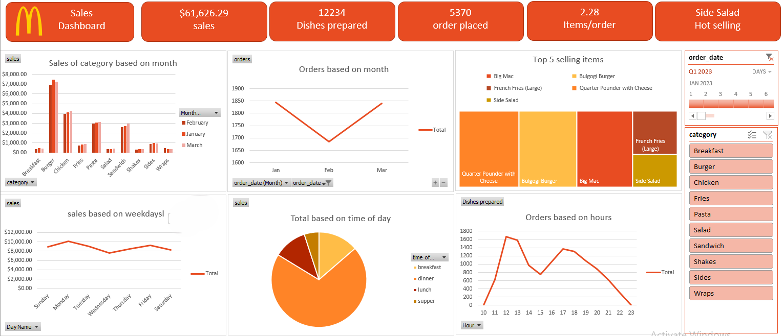

Slide 5
KEY FINDINGS
Burger is the highest revenue-generating product category.
Meatball Marinara generates higher revenue despite lower sales volume than several top-selling products.
More than 60% of orders contain multiple items , indicating strong potential for cross-selling.
Certain products are frequently purchased together , particularly burgers with side items.
Sales performance varies significantly across products , showing that volume alone does not determine revenue contribution.

Slide 6
INSIGHTS
High - volume products are effective for attracting customer , while higher - value products can contribute more revenue per sale.
Frequently paired products indicate natural customer preferences that can be used for combo creation.
Customer purchasing multiple items provide an opportunity to increase Average order value.
Product - level analysis reveals opportunities that are not visible from overall category or daily sales alone.

Slide 7
RECOMMENDATIONS
Create data driven combo offer using products that are frequently purchased together.
Promote high – value products through premium combos and targeted upselling.
Use high – volume products as entry products based on both sales volume and revenue before making menu decisions.
Review low – performing products based on both sales volume and revenue before making menu decisions.

Slide 8
THANKU YOU
PRESENTED BY MADHAV SONI

